Slide 1
Interaction Diagrams

Slide 2
Two Kinds of Object Models
Dynamic models, such as UML interaction diagrams (sequence diagrams or communication diagrams),
  the behavior of the code
  the method bodies
Static models, such as UML class diagrams,
  the definition of packages,
  class names,
  attributes,
  method signatures (but not method bodies).

Slide 3
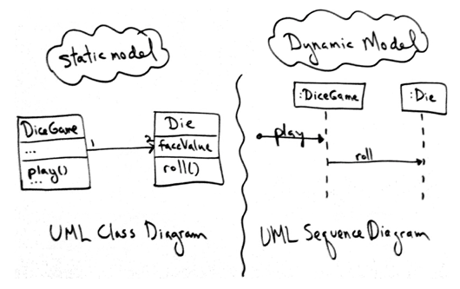
Static and dynamic UML diagrams

Slide 4
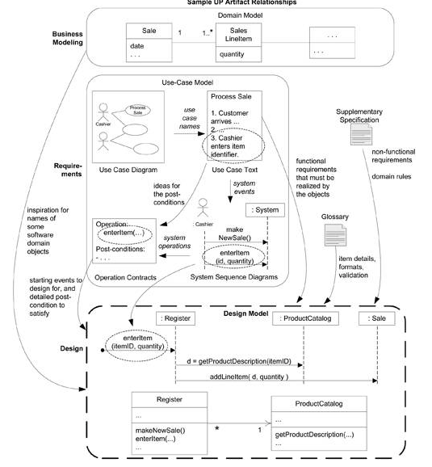

Slide 5
Interaction Diagrams
Sequence diagrams
Communication diagrams

Slide 6
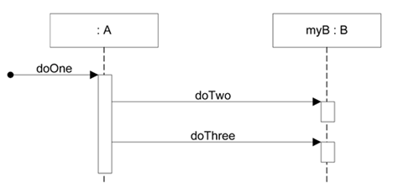
Sequence diagram

Slide 7
public class A {
private B
myB = new B();
public void doOne() {
myB.doTwo();
myB.doThree();
}
// …
}

Slide 8
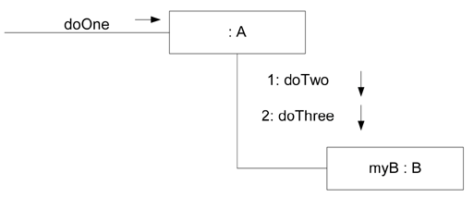
Communication diagram

Slide 9
Type | Strengths | Weaknesses
sequence | -clearly shows sequence or time ordering of messages -large set of detailed notation options | -forced to extend to the right when adding new objects; consumes horizontal space
communication | -space economical flexibility to add new objects in two dimensions | -more difficult to see sequence of messages -Fewer notation options

Slide 10
Example Sequence Diagram: makePayment
The message makePayment is sent to an instance of a Register. The sender is not identified.
The Register instance sends the makePayment message to a Sale instance.
The Sale instance creates an instance of a Payment.

Slide 11
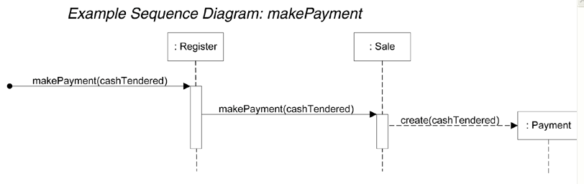
Example Sequence Diagram: makePayment

Slide 12
Example Sequence Diagram: makePayment
public class Sale {
private Payment payment;
public void makePayment( Money cashTendered ) {
payment = new Payment( cashTendered );
//…
}
// …
}

Slide 13
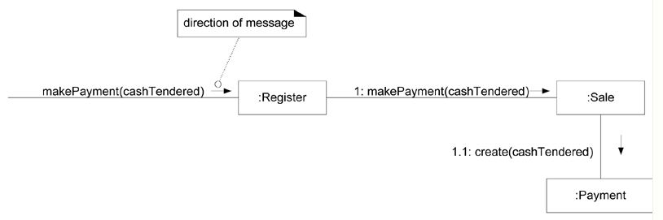
Example Communication Diagram: makePayment

Slide 14
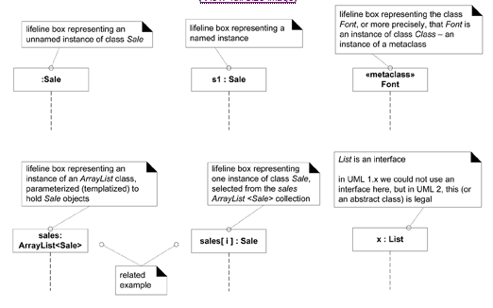

Slide 15
Basic Message Expression Syntax
return = message(parameter : parameterType) : returnType
initialize(code)
initialize
d = getProductDescription(id)
d = getProductDescription(id:ItemID)
d = getProductDescription(id:ItemID) : ProductDescription

Slide 16
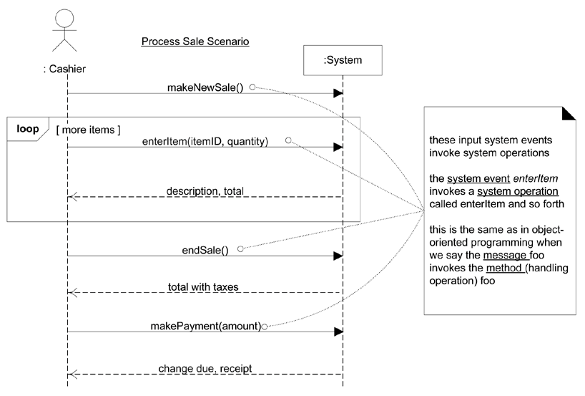
SSD for Process Sale Use Case

Slide 17
The Events in Process Sale SSD
makeNewSale
enterItem
endSale
makePayment

Slide 18
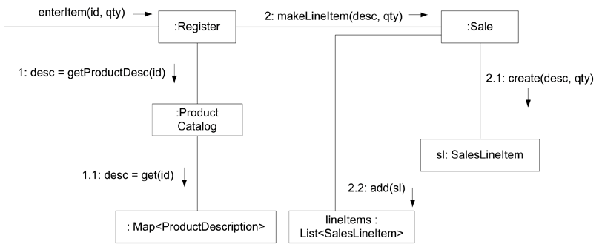
Collobration Diagram for EnterItem Event

Slide 19
Notation for Interaction Diagrams
15.4. Basic Sequence Diagram Notation
15.5. Basic Communication Diagram Notation

